Slide 1

Применение цифровых ресурсов в образовании
Выполнил: учитель русского языка и литературы
Гробовец Ирина Анатольевна
Г. Туапсе, 2021

Slide 2
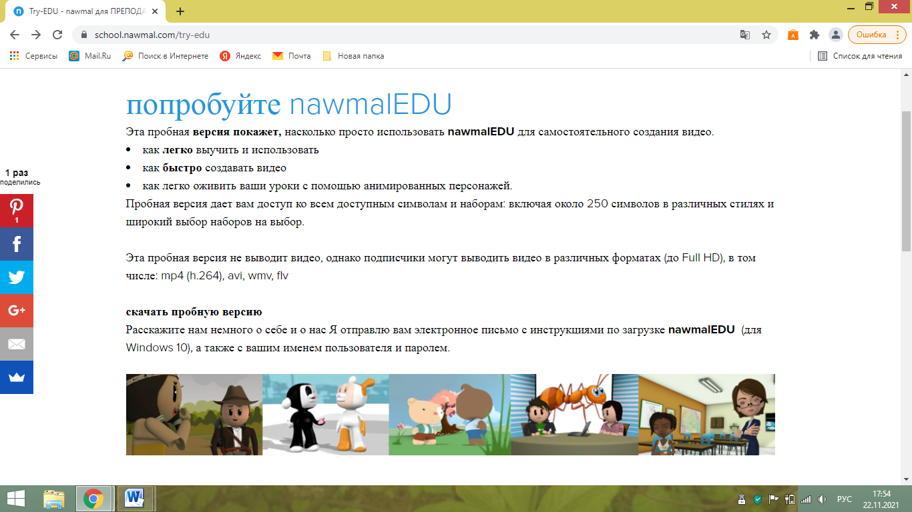

Slide 3
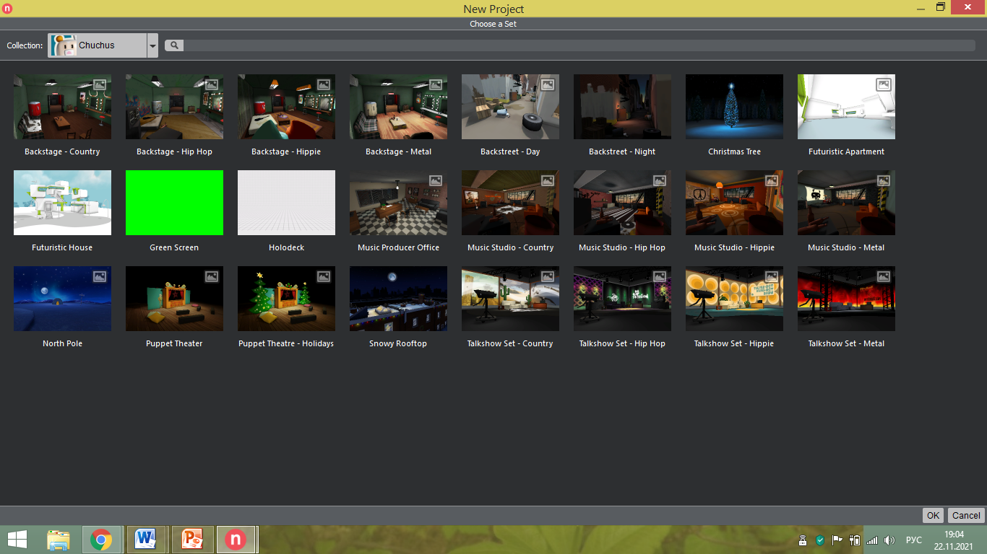

Slide 4
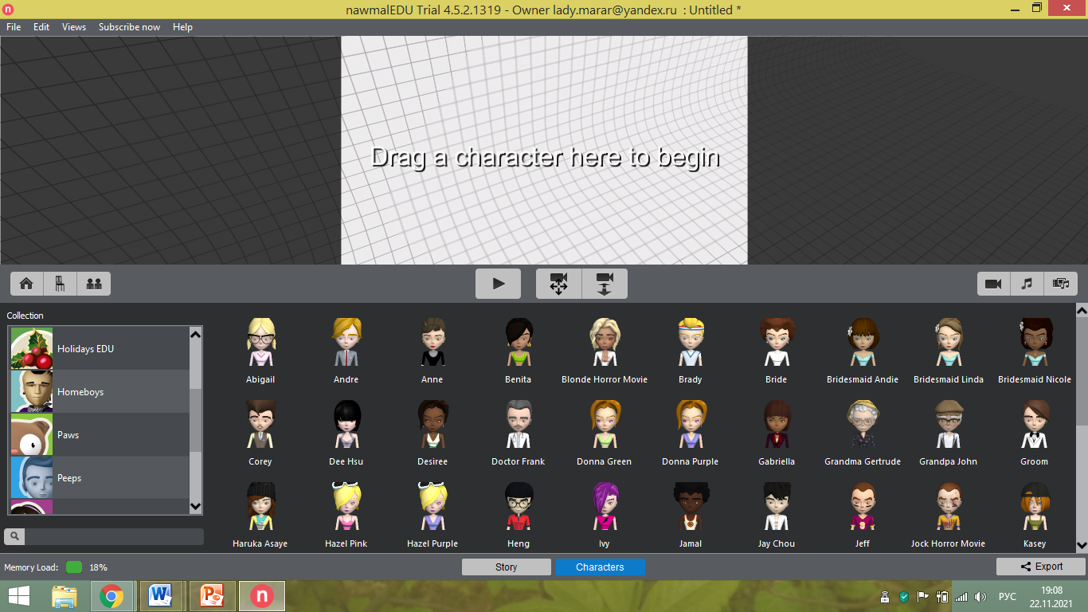
https://school.nawmal.com/showcase

Slide 5
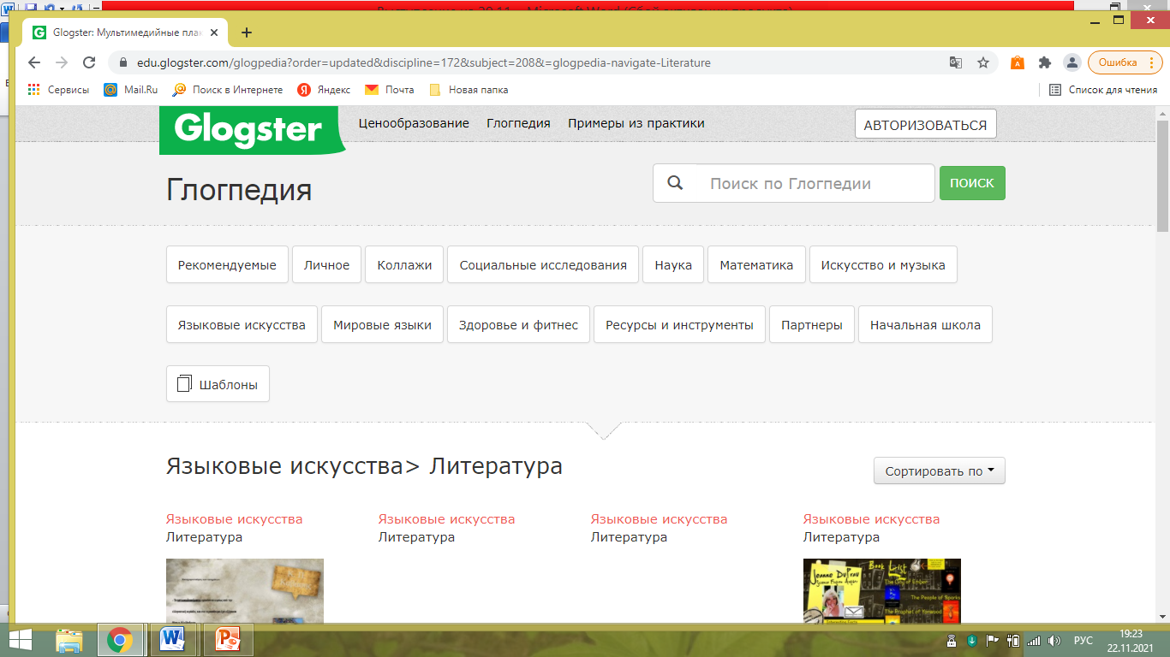

Slide 6
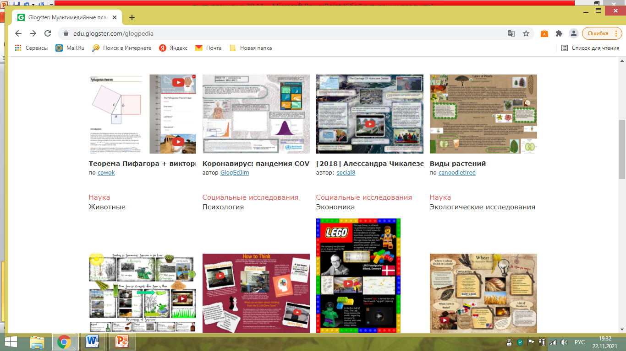

Slide 7
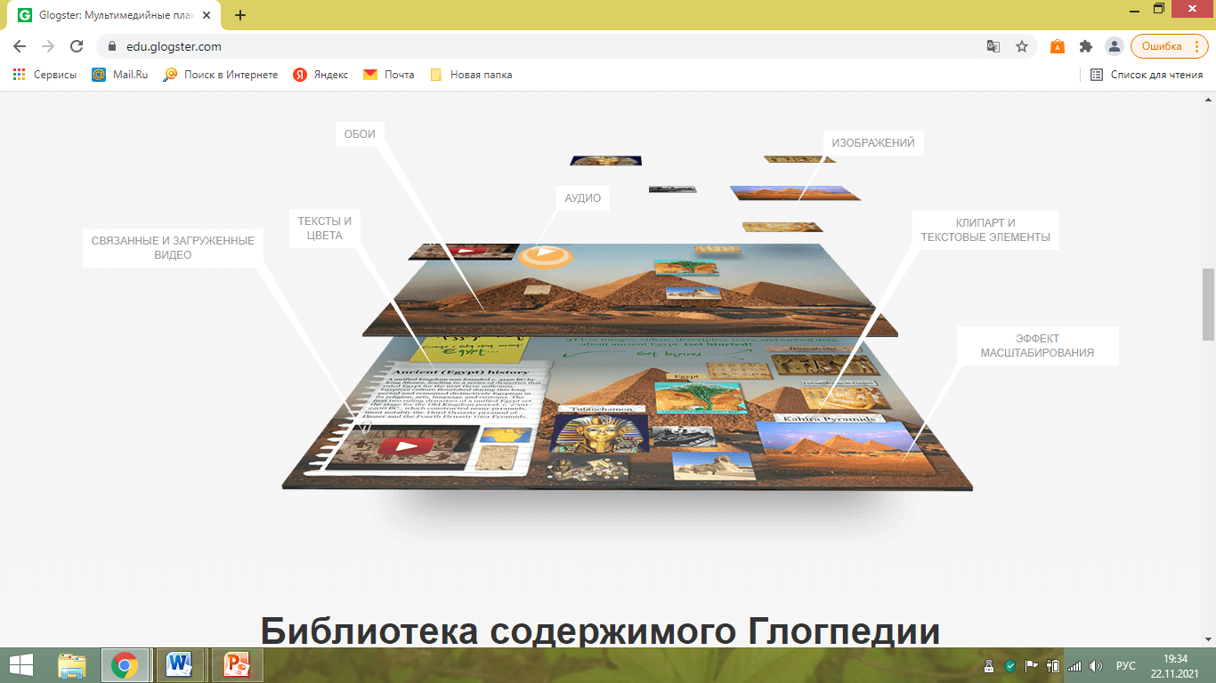

Slide 8
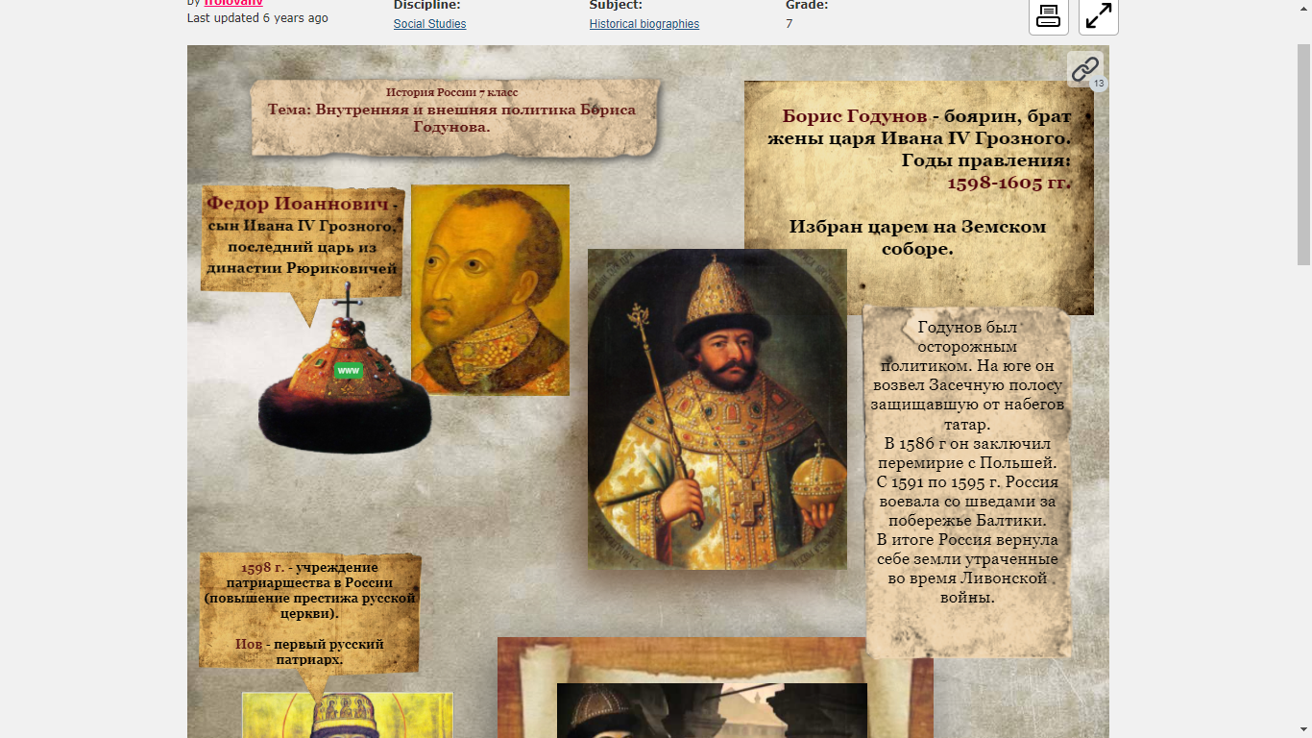
https://edu.glogster.com/glog/boris-godunov/240ac968io6?=glogpedia-source

Slide 9
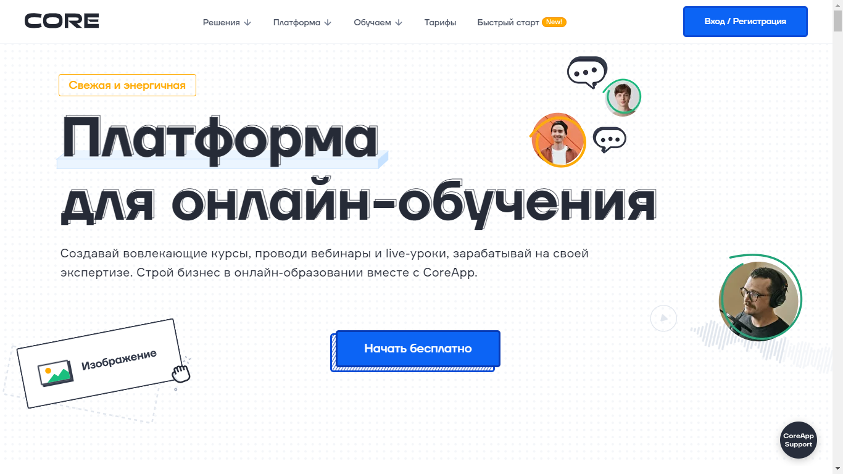

Slide 10
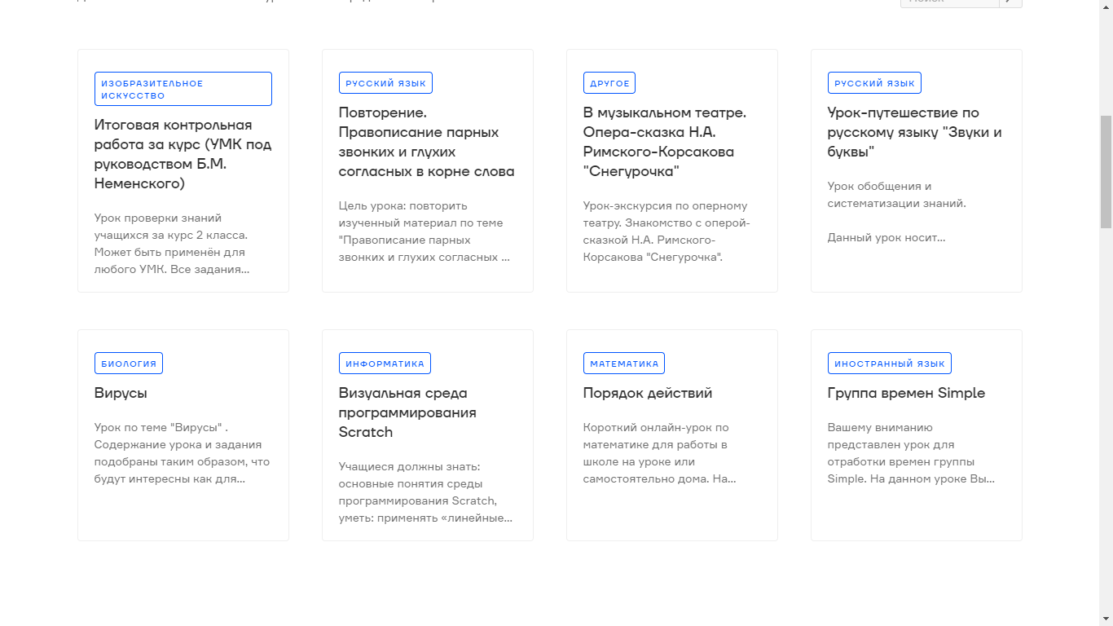

Slide 11
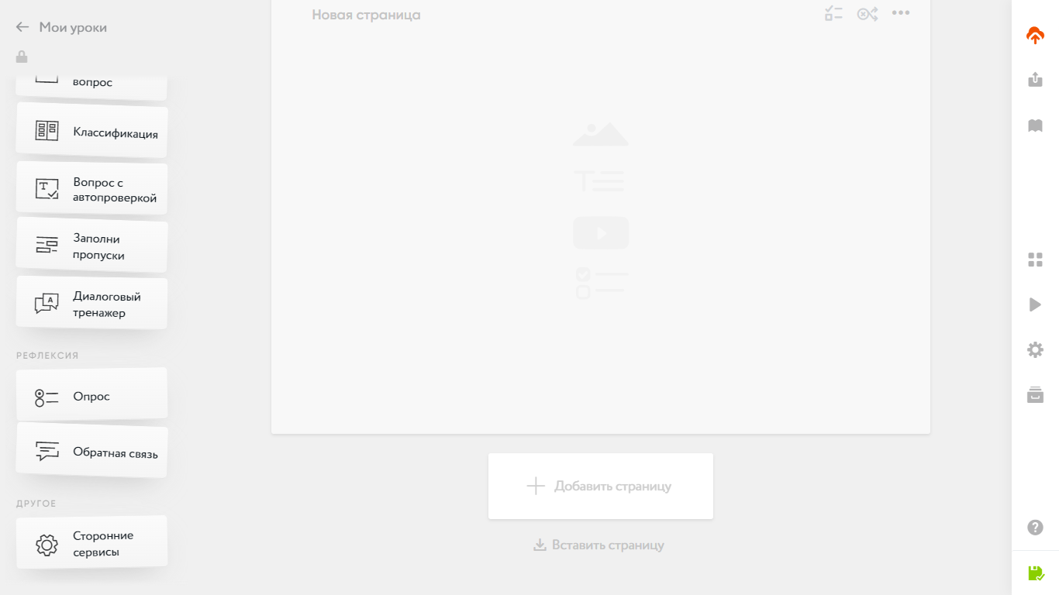
https://coreapp.ai/app/preview/lesson/5fc13683f61da144710e98ee

Slide 12
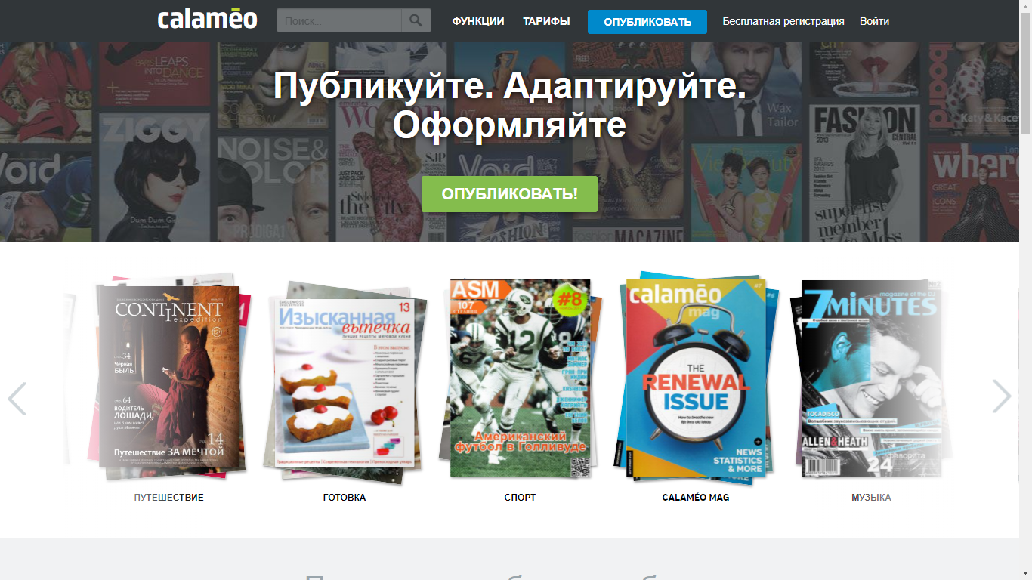

Slide 13
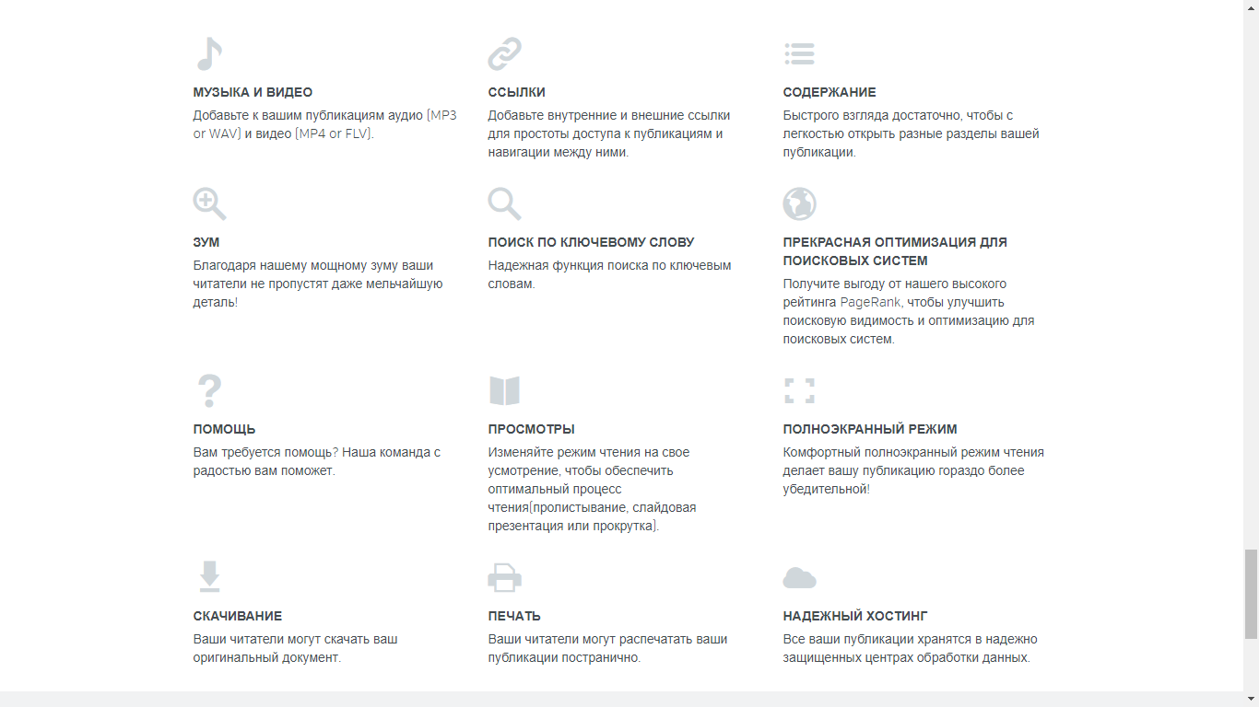

Slide 14
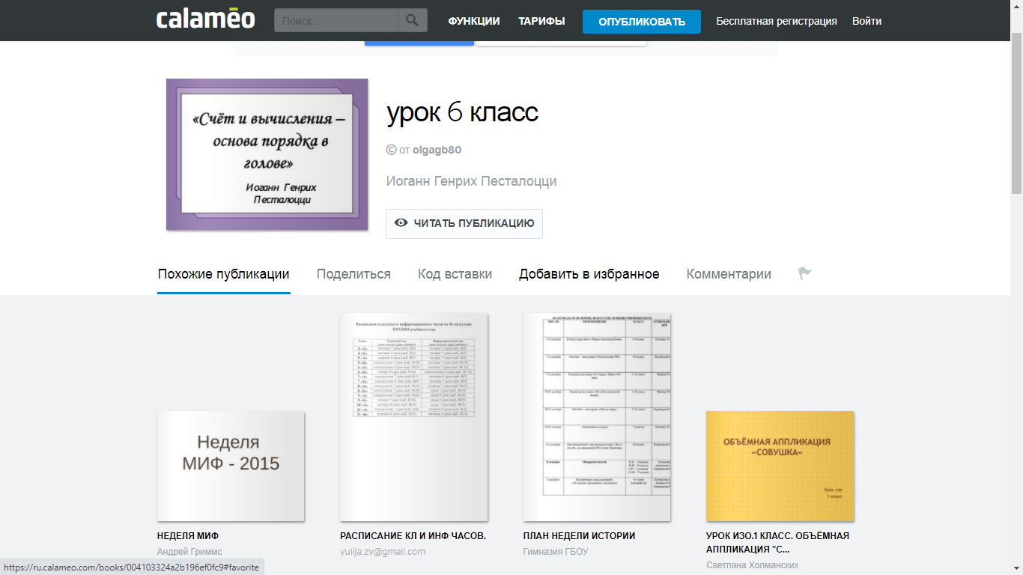

Slide 15
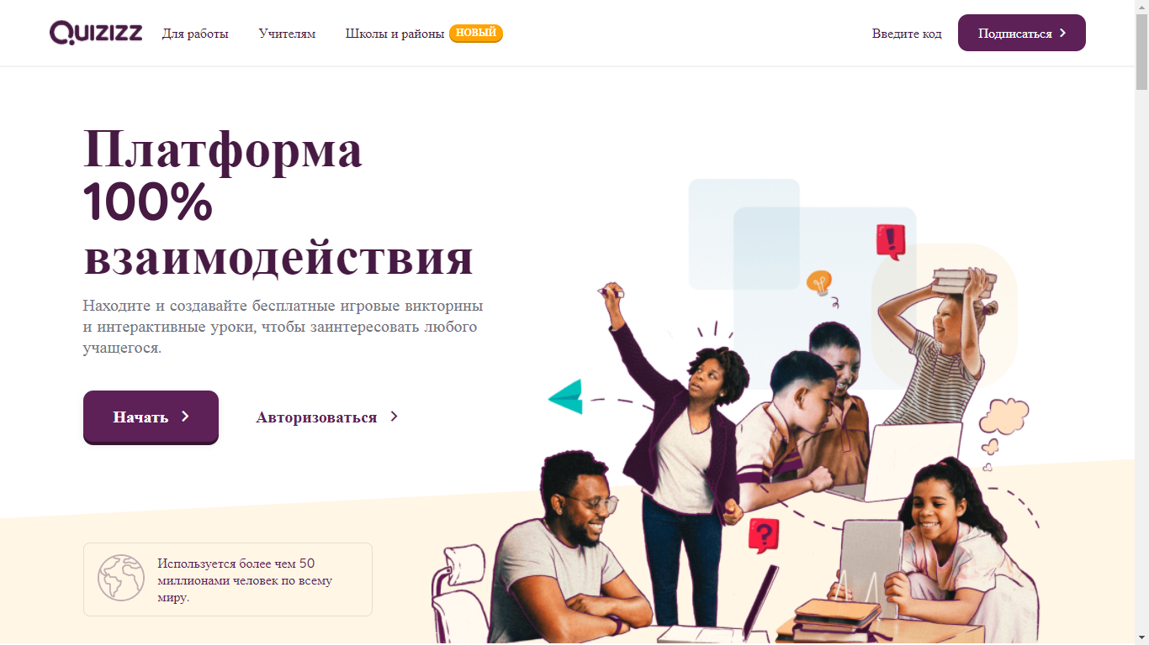

Slide 16
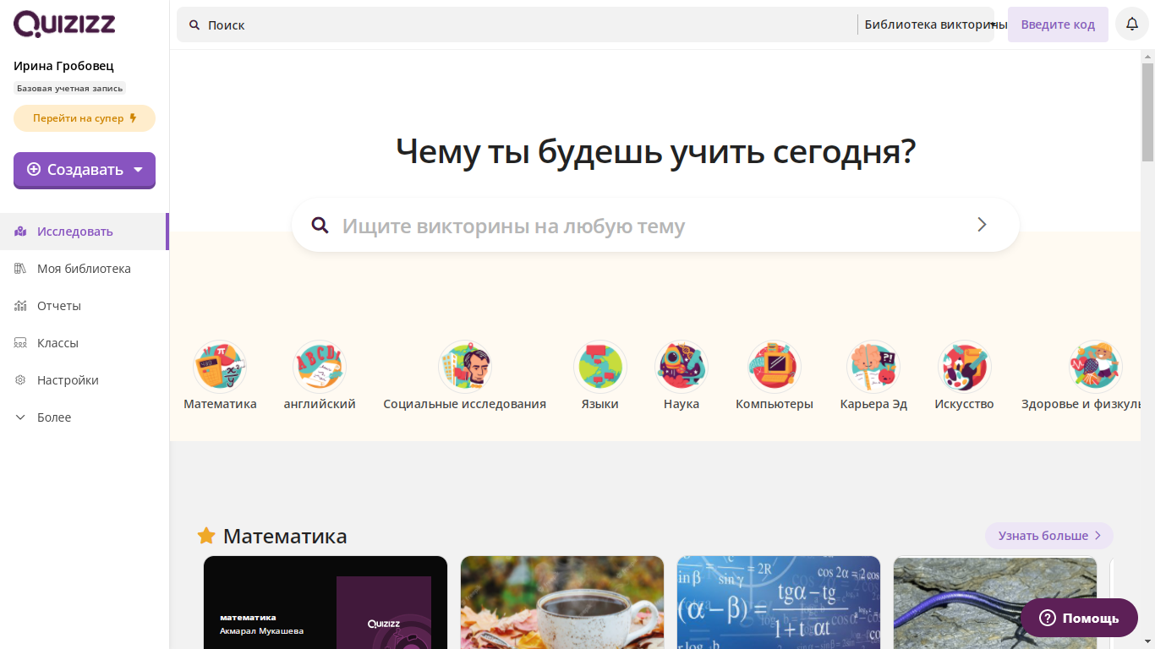

Slide 17
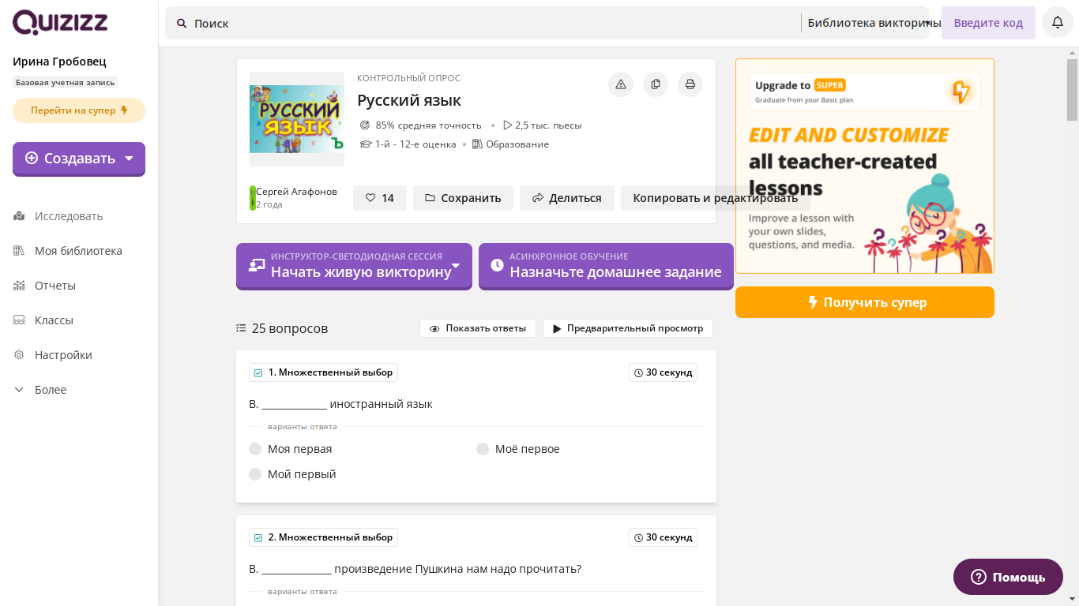

Slide 18
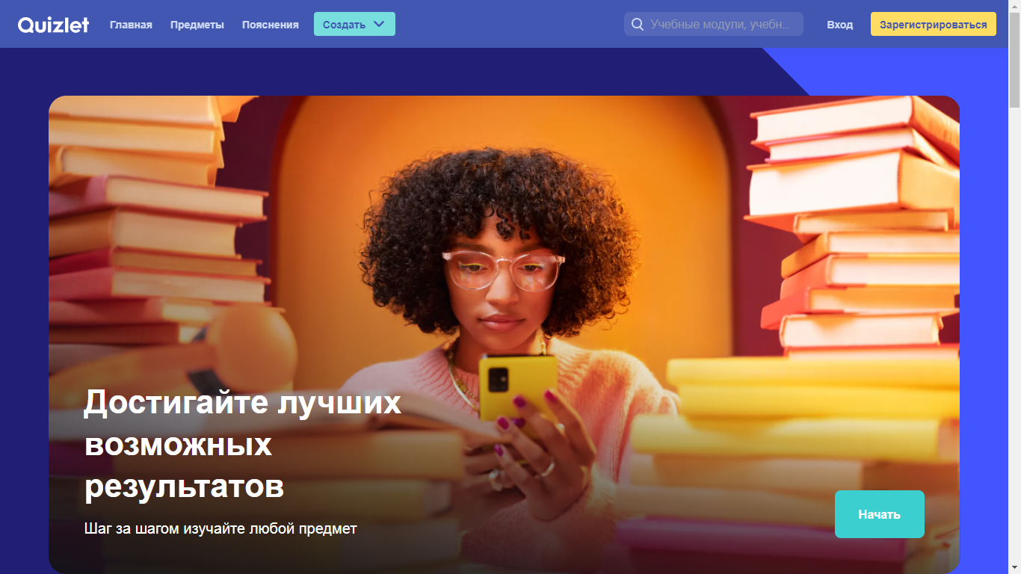
https://quizlet.com/268932236/%D0%BB%D0%B8%D1%82%D0%B5%D1%80%D0%B0%D1%82%D1%83%D1%80%D0%B0-flash-cards/

Slide 19

https://quizlet.com/
https://quizizz.com/
https://ru.calameo.com/
https://ru.coreapp.ai/
https://www.renderforest.com/ru/
https://edu.glogster.com/glogpedia
https://www.nawmal.com/
https://kahoot.com/
https://h5p.org/
https://www.mentimeter.com/
https://www.videoscribe.co/
https://mfactory.club/
https://iqsha.ru/
https://udoba.org/
https://barabook.ru/

