Slide 1
Today is the 28th of April
Seasons and Months

Slide 2
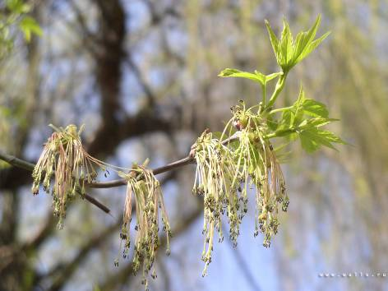
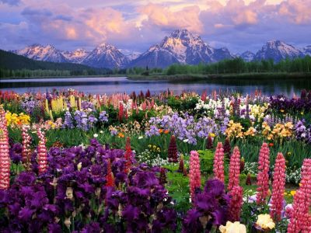
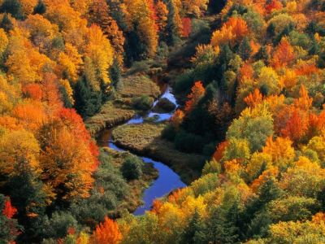
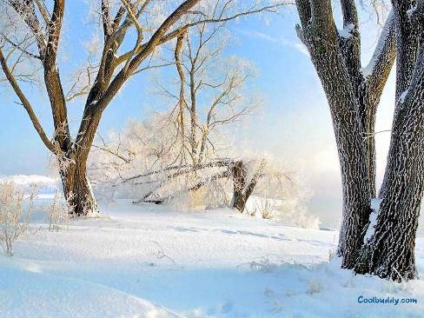
spring
green
summer
bright
winter
white
autumn
yellow

Slide 3
Spring is green
Summer is bright
Autumn is yellow
Winter is white

Slide 4
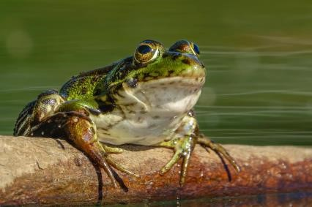
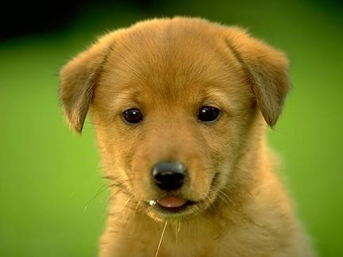
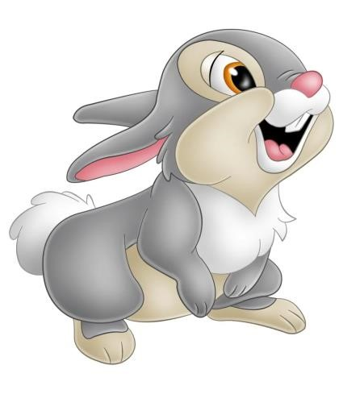
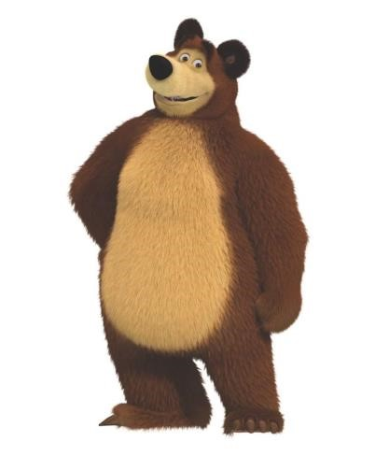
[ð]
This is a dog
This is a frog
This is a bear
This is a hare

Slide 5
Глаголы движения. Read and Translate
Run, swim, play football, play hockey, play tennis, skip, ride a bike, make a snowman, play snowballs, ski, skate, play badminton, walk in the park, have a picnic.

Slide 6
Ответьте на вопросы. Answer the questions
What is your favourite season?
My favourite season is…. .
Why do you …. ?
I like … because I can …. .

Slide 7
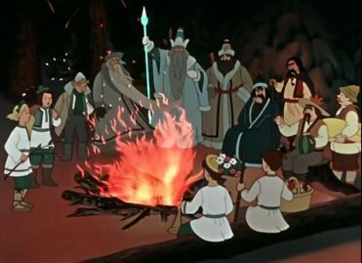
Who are they? Кто они?
Twelve months

Slide 8
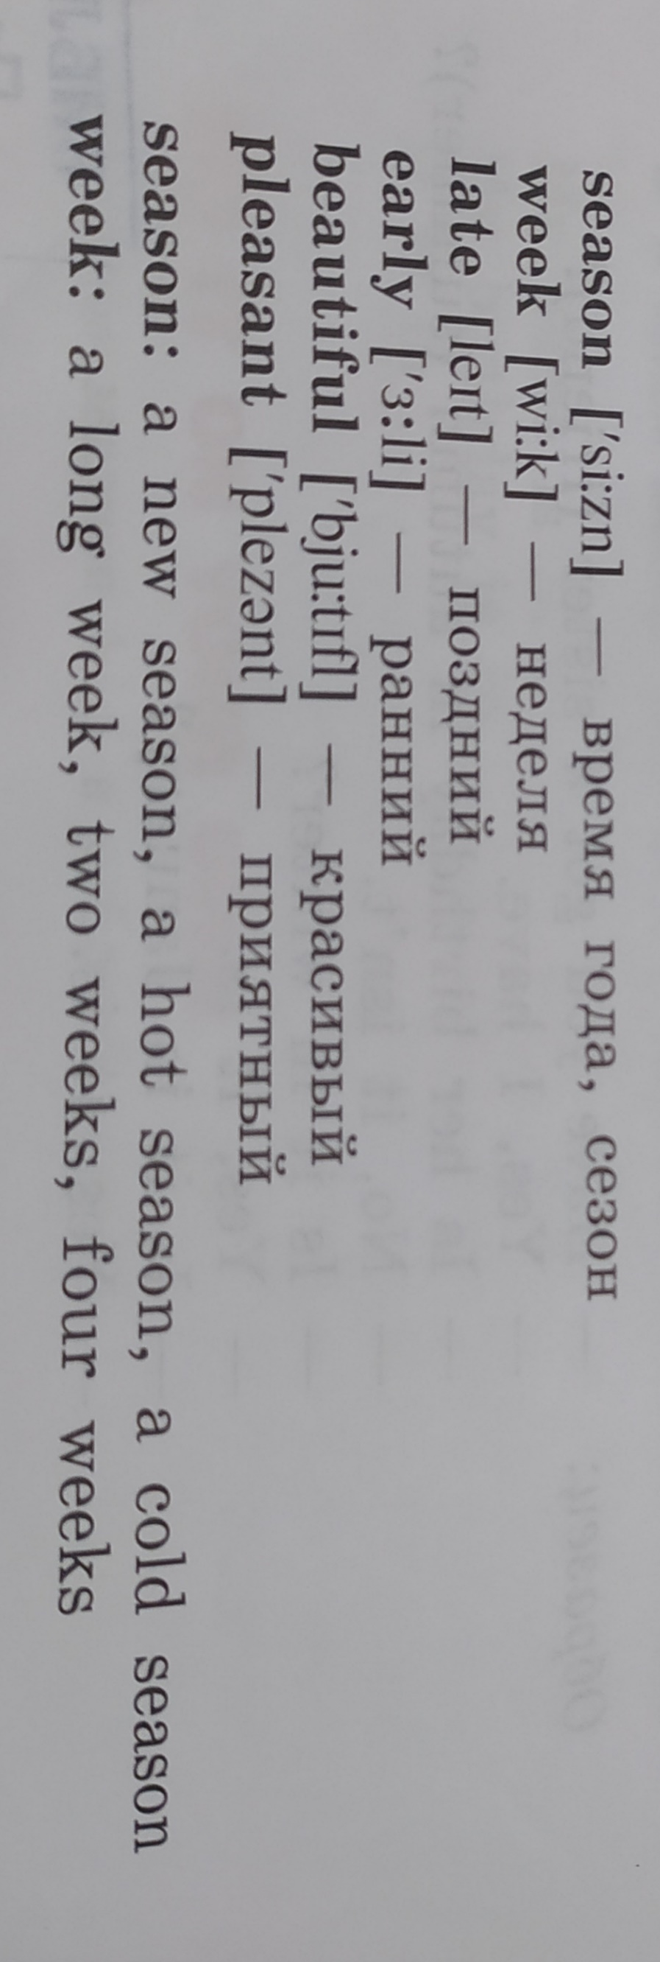
Vocabulary. New words

Slide 9
12 months in a year:
January [‘ʤænju(ə)rɪ] — январь
February [‘febru(ə)rɪ] — февраль
March [mɑːʧ] — март
April [‘eɪpr(ə)l] — апрель
May [meɪ] — май
June [ʤuːn] — июнь
July [ʤu’laɪ] — июль
August [‘ɔːgəst] — август
September — сентябрь
October [ɔk’təubə] — октябрь
November [nəu’vembə] — ноябрь
December [dɪ’sembə] — декабрь

Slide 10
What are winter months?
October
January
September
March
June
February
November
July
December

Slide 11
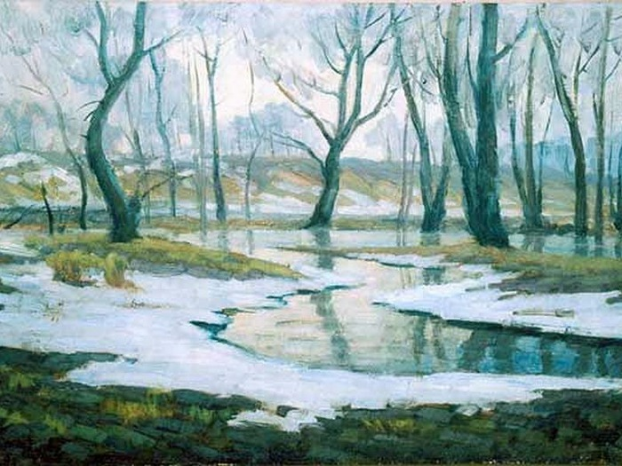
What are spring months?
April
June
February
May
March
August
July
January
October

Slide 12
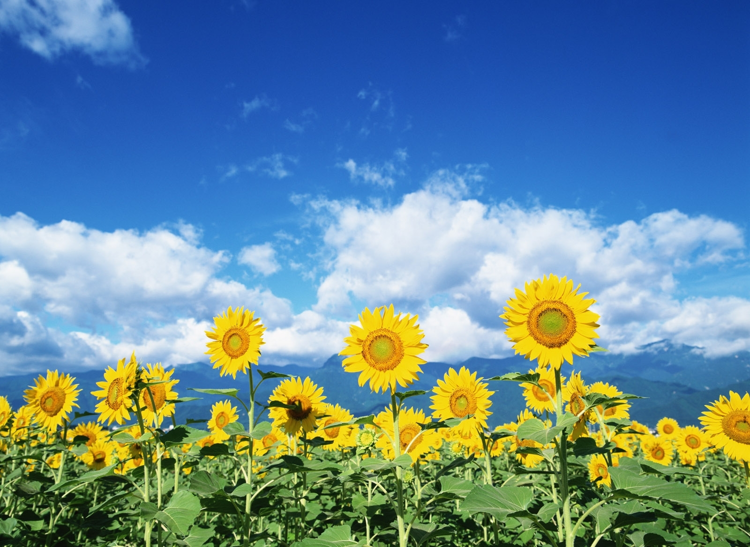
What are summer months?
November
June
October
March
May
September
August
April
July

Slide 13
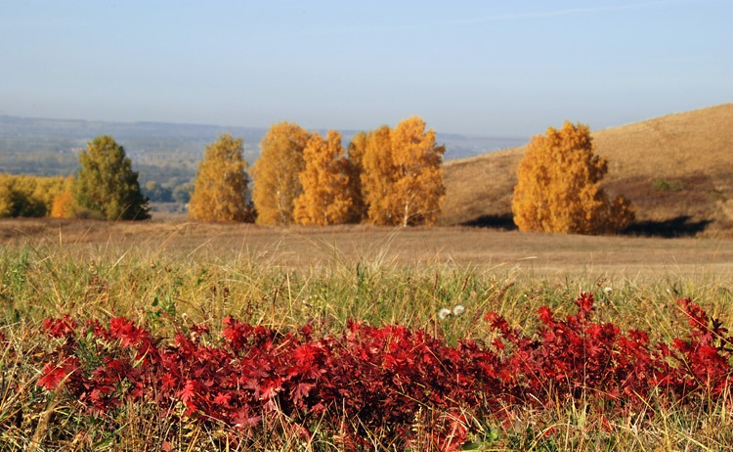
What are autumn months?
December
October
January
November
August
February
April
September
March

Slide 14
Прочитай сначала за диктором, а затем самостоятельно.

Slide 15
Посмотри, как Дэвид выполнил свое домашнее задание и скажи, где он ошибся.

Slide 16
Вставьте слова из таблицы в предложения.
Birds sing in ___________.
Children swim in lakes in ___________.
Trees are yellow and red in ___________.
Bears sleep in ______________.
I can see a big house __________ the lake.
Where are you, Bob? – I am ________.
How old are you? I'm two _________ old.
You can see birds in the _________ blue sky.
years | near | clear | here
spring | autumn | winter | summer

Slide 17
Homework
Упр. 4, с. 66 (учебник) выучить новые слова, упр. 2-3, с. 119 (рабочая тетрадь), написать слова, заполнить пропуски

Slide 18
Have a nice day!
Goodbye!

