Slide 1

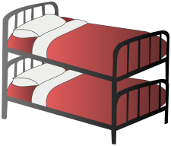




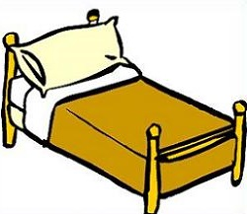








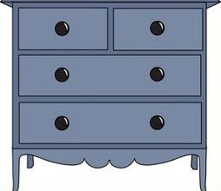

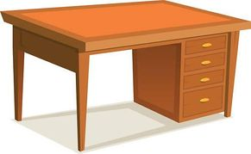

LISTENING
WHAT AM I?
Listen to the
definitions and click the right picture.
IN THE BEDROOM

Slide 2


In the bedroom
WHAT AM I?
Listen to the
definition and click the right picture.
Check the definition.
Two people can sleep in it next to each other.
DOUBLE BED

Slide 3


In the bedroom
WHAT AM I?
Listen to the
definition and click the right picture.
Check the definition.
You can switch me on and off. I provide light.
READING LAMP

Slide 4
In the bedroom
WHAT AM I?
Listen to the
definition and click the right picture.
Check the definition.
I am flat and usually attached to the wall. You can put
things on me.
SHELF

Slide 5


In the bedroom
WHAT AM I?
Listen to the
definition and click the right picture.
Check the definition.
I am a small table that is kept at the side of a bed.
BEDSIDE TABLE

Slide 6


In the bedroom
WHAT AM I?
Listen to the
definition and click the right picture.
Check the definition.
I am a piece of furniture with shelves to put books on.
BOOKCASE

Slide 7
In the bedroom
WHAT AM I?
Listen to the
definition and click the right picture.
Check the definition.
I’m usually soft and you can find me on your bed.
PILLOW

Slide 8
In the bedroom
WHAT AM I?
Listen to the
definition and click the right picture.
Check the definition.
I wake you up in the morning.
ALARM CLOCK

Slide 9


In the bedroom
WHAT AM I?
Listen to the
definition and click the right picture.
Check the definition.
We are two beds attached together, one on top of the other.
BUNK BED

Slide 10

In the bedroom
WHAT AM I?
Listen to the
definition and click the right picture.
Check the definition.
I’m a piece of furniture with drawers in which you can put your clothes.
CHEST OF DRAWERS

Slide 11


In the bedroom
WHAT AM I?
Listen to the
definition and click the right picture.
Check the definition.
You can look at your own reflection in me.
MIRROR

Slide 12

In the bedroom
WHAT AM I?
Listen to the
definition and click the right picture.
Check the definition.
I’m used for covering the floor or for decoration.
RUG

Slide 13

In the bedroom
WHAT AM I?
Listen to the
definition and click the right picture.
Check the definition.
You can sit on me but I have no back or arms.
STOOL

Slide 14
In the bedroom
WHAT AM I?
Listen to the
definition and click the right picture.
Check the definition.
I’m a narrow bed for one person to sleep in.
SINGLE BED

Slide 15

In the bedroom
WHAT AM I?
Listen to the
definition and click the right picture.
Check the definition.
I’m a type of table that you can work at, often one with drawers.
DESK

Slide 16
In the bedroom
WHAT AM I?
Listen to the
definition and click the right picture.
Check the definition.
I’m a seat with a back, legs and arms.
CHAIR

Slide 17

In the bedroom
WHAT AM I?
Listen to the
definition and click the right picture.
Check the definition.
I’m a tall cupboard in which you hang your clothes.
WARDROBE

