Slide 1

Enter
Enter
HAUNTED HOUSE
By Artem Morozov
Enter
© Artem Morozov, 2021

Slide 2

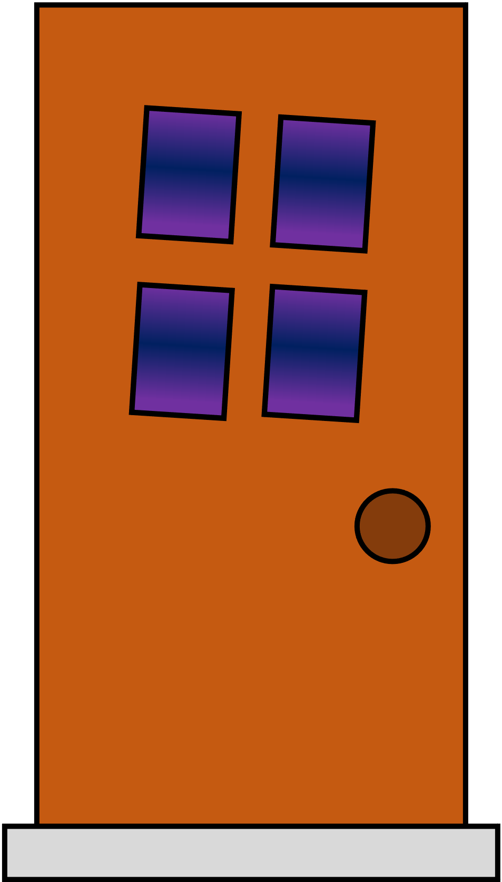
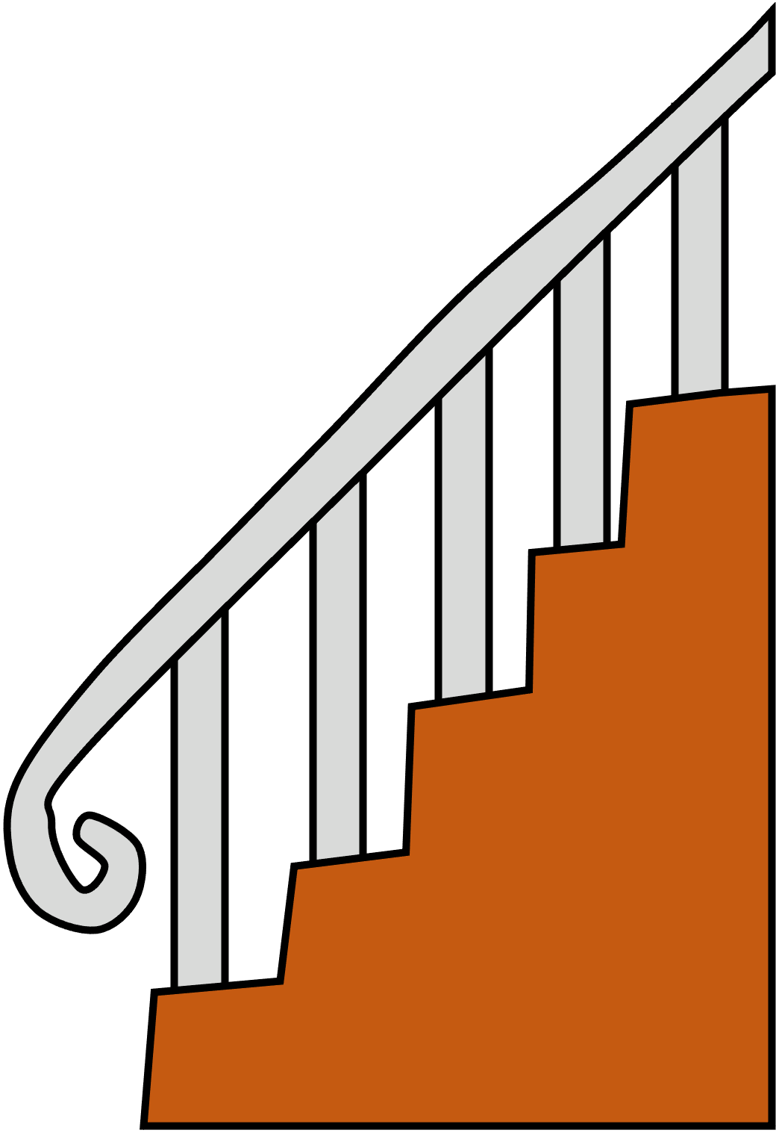


Go outside
Upstairs

Slide 3
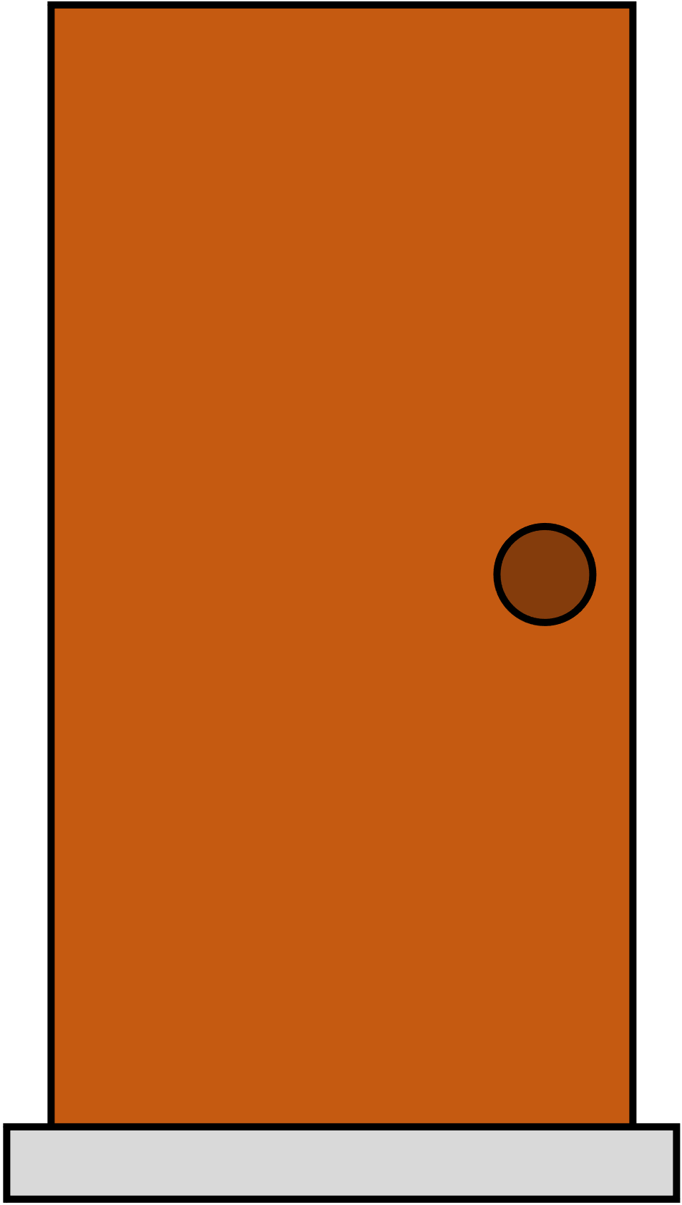
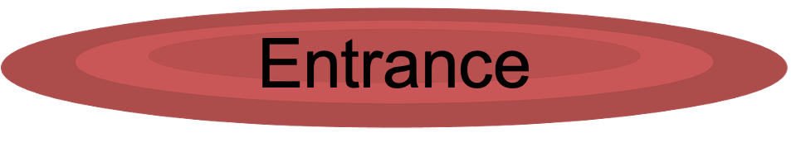
Dining room
Kitchen
Living room

Slide 4






Hallway

Slide 5
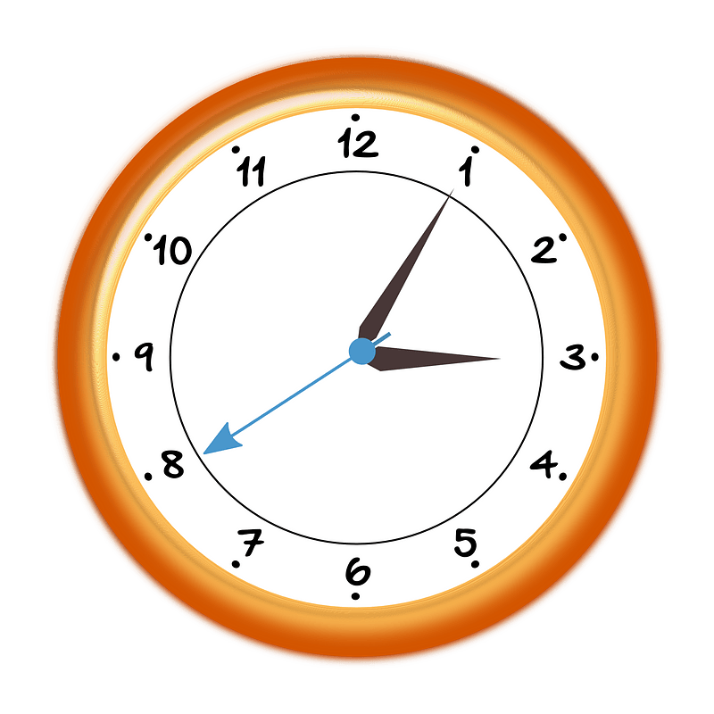





Hallway

Slide 6




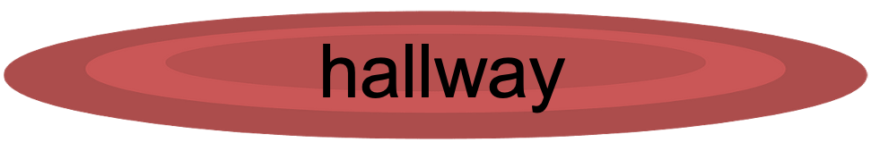
bedroom

Slide 7


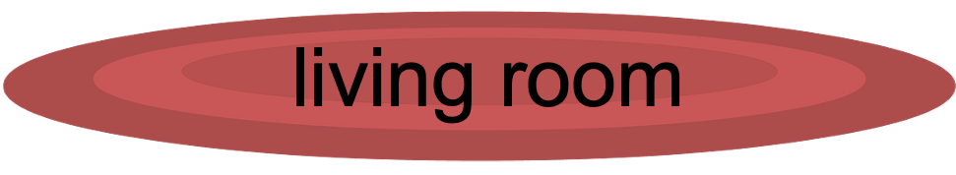
Bathroom
Attic

Slide 8
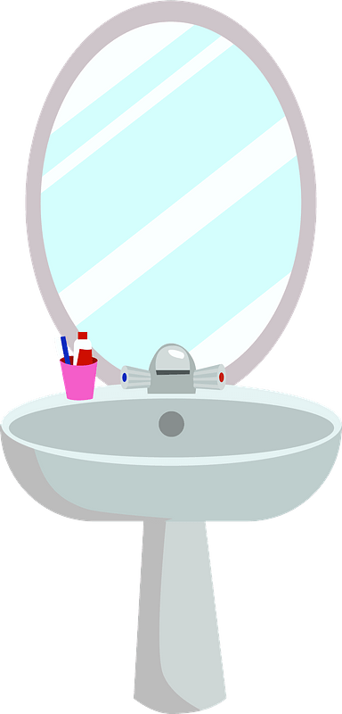


Bedroom

Slide 9





Living room

