Slide 1




have/has +
past participle

Slide 2




lose
lost
lost
feel
ride
tell
lose
have
break
work
spend
sell
leave
forget
Choose the correct verb.
see
speak
get
fall
drink
be
eat
win
meet
Brian_________ his first tooth.
has lost

Slide 3
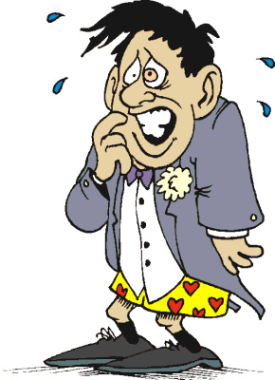
feel
ride
tell
lose
have
break
work
spend
sell
forget
forgot
forgotten
leave
forget
Choose the correct verb.
see
speak
get
fall
drink
be
eat
win
meet
I think I ________________ my trousers.
have forgotten

Slide 4
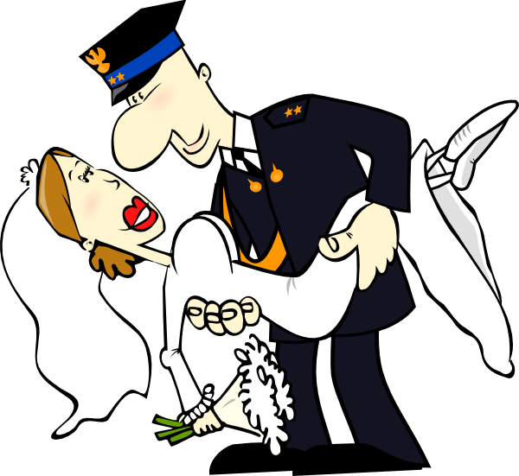
feel
ride
tell
lose
have
break
work
spend
sell
leave
forget
Choose the correct verb.
see
speak
get
got
got / gotten
get
fall
drink
be
eat
win
meet
Bob and Sue _____ just ____ married.
have got

Slide 5
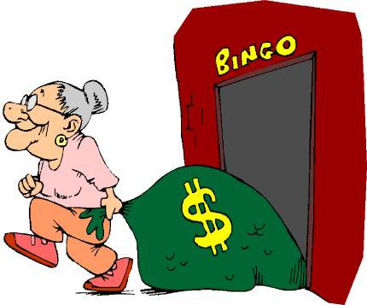
feel
ride
tell
lose
have
break
work
spend
sell
leave
forget
Choose the correct verb.
see
speak
get
fall
drink
be
eat
win
won
won
win
meet
It’s the second time this week that granny________ a game of bingo.
has won

Slide 6
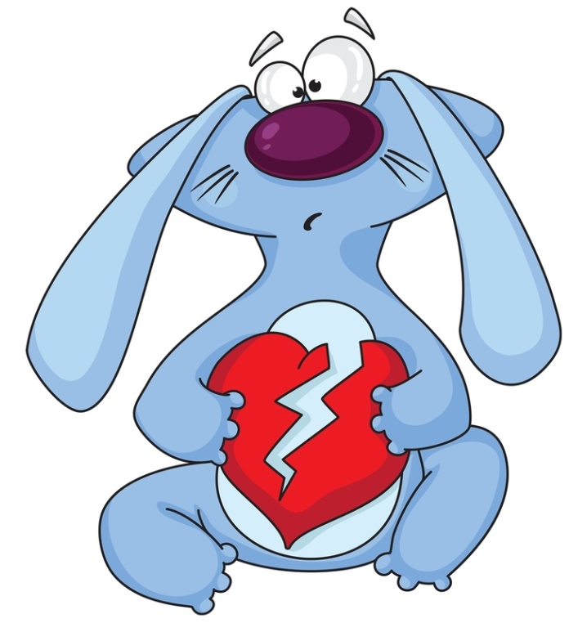
feel
ride
tell
lose
have
break
broke
broken
break
work
spend
sell
leave
forget
Choose the correct verb.
see
speak
get
fall
drink
be
eat
win
meet
Who ___________ your heart again?
has broken

Slide 7
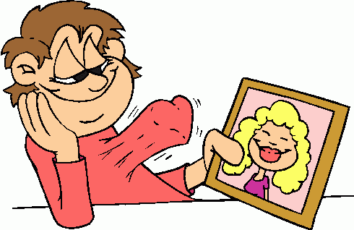
feel
ride
tell
lose
have
break
work
spend
sell
leave
forget
Choose the correct verb.
see
speak
get
fall
fell
fallen
fall
drink
be
eat
win
meet
has fallen
He __________ in love with
the new girl in his class.

Slide 8
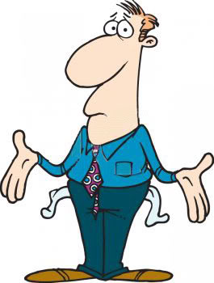
feel
ride
tell
lose
have
break
work
spend
spent
spent
spend
sell
leave
forget
Choose the correct verb.
see
speak
get
fall
drink
be
eat
win
meet
I___________ all my money.
have spent

Slide 9

feel
ride
tell
lose
have
break
work
spend
sell
leave
forget
Choose the correct verb.
see
speak
get
fall
drink
be
was / were
been
be
eat
win
meet
_____ you ever______late for work?
Have been

Slide 10
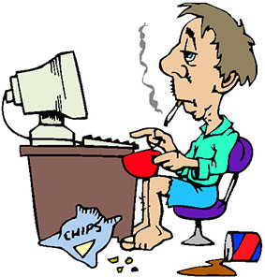
feel
ride
tell
lose
have
break
work
worked
worked
work
spend
sell
leave
forget
Choose the correct verb.
see
speak
get
fall
drink
be
eat
win
meet
My father____________ hard all day.
has worked

Slide 11
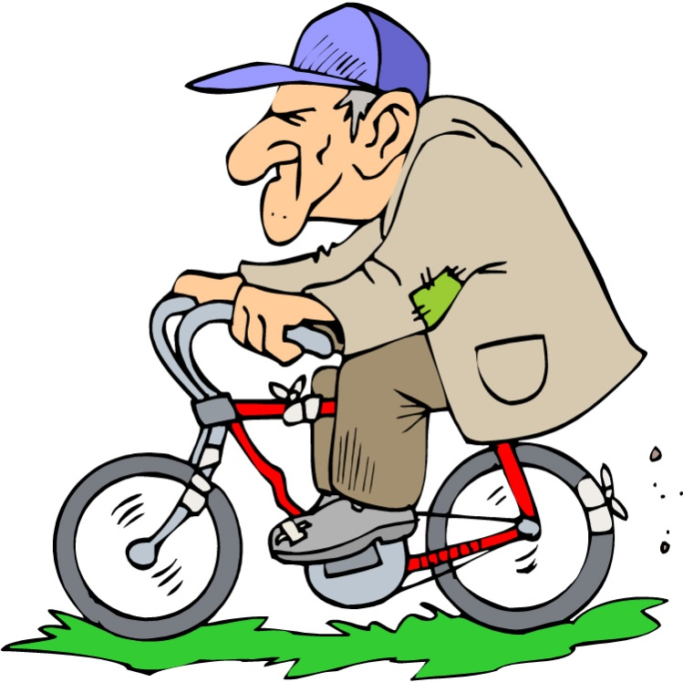
feel
ride
rode
ridden
ride
tell
lose
have
break
work
spend
sell
leave
forget
Choose the correct verb.
see
speak
get
fall
drink
be
eat
win
meet
I_____ never _______ a bike before.
have ridden

Slide 12
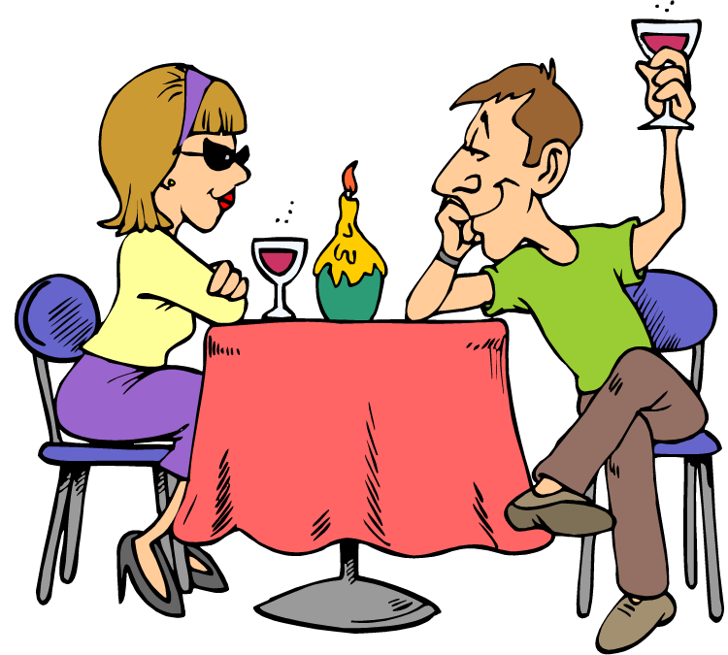
feel
ride
tell
lose
have
had
had
have
break
work
spend
sell
leave
forget
Choose the correct verb.
see
speak
get
fall
drink
be
eat
win
meet
have had
We _________ dinner together
a few times this week.

Slide 13
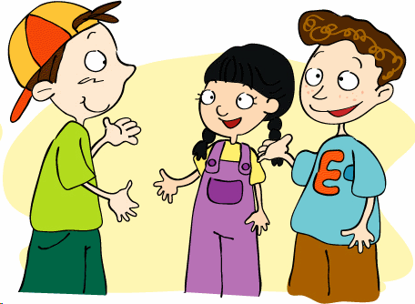
feel
ride
tell
lose
have
break
work
spend
sell
leave
forget
Choose the correct verb.
see
speak
get
fall
drink
be
eat
win
meet
met
met
meet
have met
I _____ finally _____ Lucy, the new student from the USA.

Slide 14
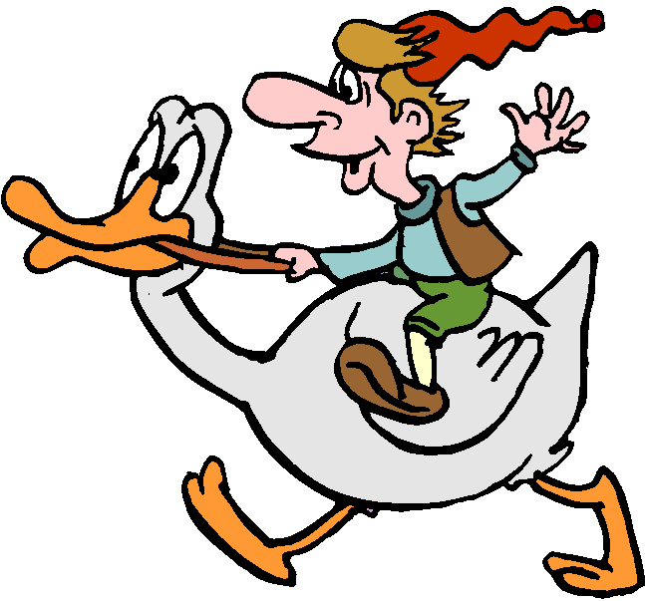
feel
ride
tell
lose
have
break
work
spend
sell
leave
forget
Choose the correct verb.
see
saw
seen
see
speak
get
fall
drink
be
eat
win
meet
Have seen
_____ you ever _____ someone riding a duck?

Slide 15
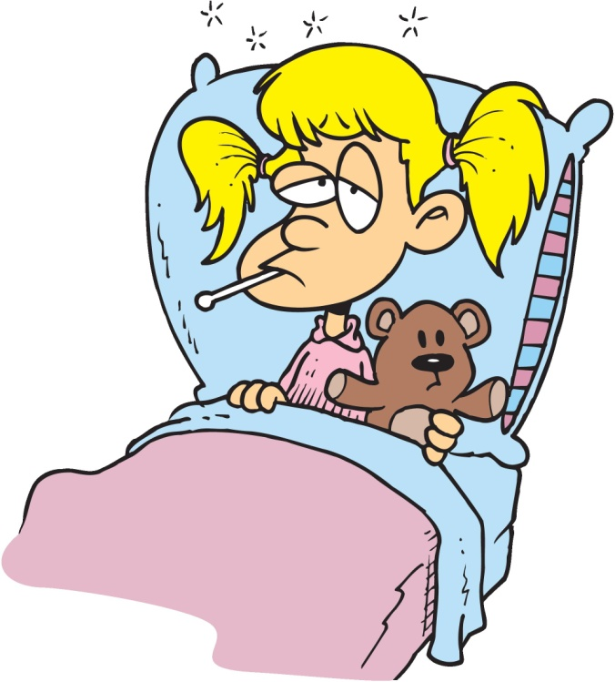
feel
felt
felt
feel
ride
tell
lose
have
break
work
spend
sell
leave
forget
Choose the correct verb.
see
speak
get
fall
drink
be
eat
win
meet
She________ very sick since Friday.
has felt

Slide 16
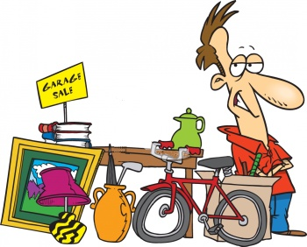
feel
ride
tell
lose
have
break
work
spend
sell
sold
sold
sell
leave
forget
Choose the correct verb.
see
speak
get
fall
drink
be
eat
win
meet
Michael____ not _____ all his stuff yet.
has sold

Slide 17
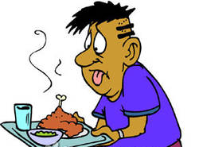
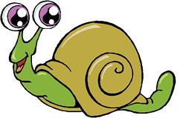
feel
ride
tell
lose
have
break
work
spend
sell
leave
forget
Choose the correct verb.
see
speak
get
fall
drink
be
eat
ate
eaten
eat
win
meet
Seth_____never ______ snails before.
has eaten

Slide 18
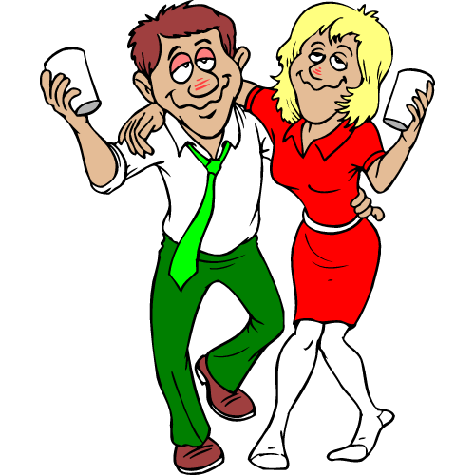
feel
ride
tell
lose
have
break
work
spend
sell
leave
forget
Choose the correct verb.
see
speak
get
fall
drink
drank
drunk
drink
be
eat
win
meet
They____________ too much.
have drunk

Slide 19
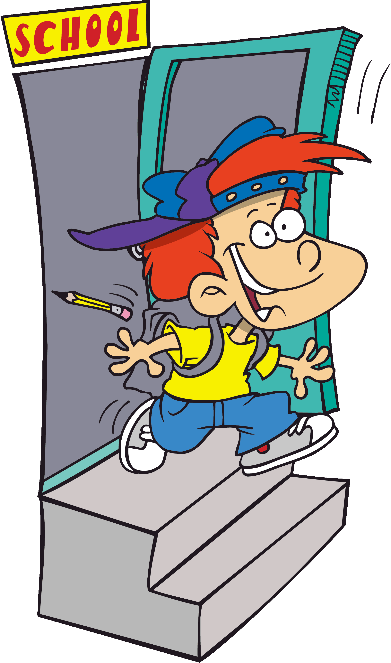
feel
ride
tell
lose
have
break
work
spend
sell
leave
left
left
leave
forget
Choose the correct verb.
see
speak
get
fall
drink
be
eat
win
meet
Rob ____ just ____ school.
has left

Slide 20
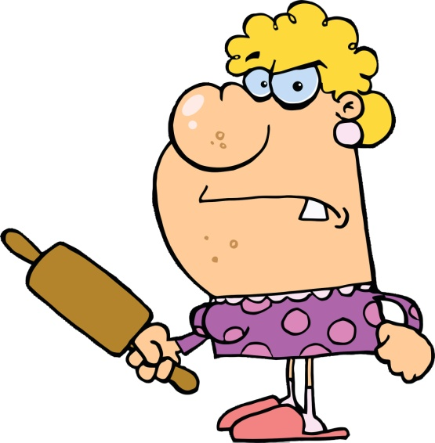
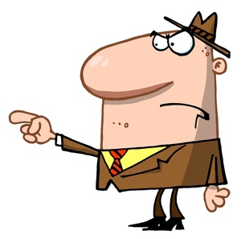
feel
ride
tell
lose
have
break
work
spend
sell
leave
forget
Choose the correct verb.
see
speak
spoke
spoken
speak
get
fall
drink
be
eat
win
meet
have spoken
We _____ not ________ to each other
since Sunday.

Slide 21
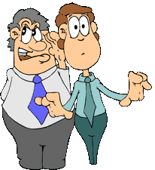

tell
told
told
feel
ride
tell
lose
have
break
work
spend
sell
leave
forget
Choose the correct verb.
see
speak
get
fall
drink
be
eat
win
meet
He________ me Jane’s secret.
has told

