Slide 1
Hello! Glad to see you!
FUTURE SIMPLE

Slide 2
FUTURE SIMPLE
FUTURE SIMPLE
Will + V1

Slide 3
Как рассказать о том, что вы будете или не будете делать
next week soon tomorrow
I play in the park every day.
I will play in the park tomorrow.

Slide 4
В разговорной речи употребляем:
I will - I’ll
He – he’ll
She – she’ll
They – they’ll
You – you’ll
We – we’ll
It – it’ll

Slide 5
I’ll be 3 next year

Slide 6
The fish will swim tomorrow

Slide 7
The bird will fly tomorrow

Slide 8
The Mouse will run next week.

Slide 9
The children will eat ice-cream next week.

Slide 10
Отрицательные предложения
Will + not = won’t
She won’t drink tea tomorrow.

Slide 11
She won’t eat apples tomorrow.

Slide 12
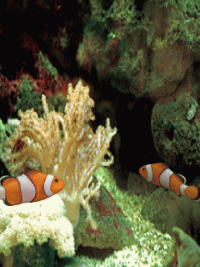
They’ll drink
They’ll swim
They’ll fly

